Slide 1









Whiteboardmaths.com
7
2
1
5
© 2004 All rights reserved

Slide 2

Standard (Index) Form
Standard form is commonly used for numbers that are very large or very small although any number can easily be written in this form. Standard form makes use of the laws of indices but numbers are only expressed in one base, base 10.
A number is in standard form if it is written as:
a x 10^{n} where 1 ≤ a < 10
Examples:
2.5 x 10³
4.62 x 10⁵
5.389 x 10⁷
1 x 10⁷
8.563 x 10¹⁷
9.562 x 10³⁴
1.4 x 10⁻⁸
8.89 x 10⁻⁴⁵
1.1 x 10⁰

Slide 3
How to write a number in standard form.
Place the decimal point after the first non-zero digit then multiply or divide it by a power of 10 to give the same value.
56
= 5.6 x 10 = 5.6 x 10¹
567
= 5.67 x 100 = 5.67 x 10²
5678
= 5.678 x 1000 = 5.678 x 10³
56789
= 5.6789 x 10 000 = 5.6789 x 10⁴
0.56
= 5.6 ÷ 10 = 5.6 x 10⁻¹
0.056
= 5.6 ÷ 100 = 5.6 x 10⁻²
0.0056
= 5.6 ÷ 1000 = 5.6 x 10⁻³
0.00056
= 5.6 ÷ 10 000 = 5.6 x 10⁻⁴
Write the following in standard form.
23
234
4585
4.6
0.78
0.053
0.00123
2.3x 10¹
2.34x 10²
4.585x 10³
4.6x 10⁰
7.8x 10⁻¹
5.3x 10⁻²
1.23x 10⁻³

Slide 4
Standard Form on a Calculator
You need to use the exponential key (EXP or EE) on a calculator when doing calculations in standard form.
Examples:
Exp/EE?
Calculate: 4.56 x 10⁸ x 3.7 x 10⁵
4.56
Exp
8
x
3.7
Exp
5
=
1.6872 x 10¹⁴
1.7 x 10¹⁴ (2sig fig)
Calculate: 5.3 x 10⁻⁴ x 2.7 x 10⁻¹³
5.3
Exp
- 4
x
2.7
Exp
- 13
=
1.431 x 10⁻¹⁶
Sharp
+/-
1.4 x 10⁻¹⁶ (2 sig fig)
Calculate: 3.79 x 10¹⁸ ÷ 9.1 x 10⁻⁵
3.79
Exp
18
÷
9.1
Exp
- 5
=
4.2 x 10²² (2 sig fig)

Slide 5
Standard Form without a Calculator
To do calculations in standard form without a calculator you need to deal with the numbers and powers of 10 separately, applying the rules of indices.
Example 1: Calculate 4.2 x 10⁸ x 9 x 10⁵
= 4.2 x 9 x 10⁸ x 10⁵
= 37.8 x 10¹³
= 3.78 x 10¹ x 10¹³
= 3.78 x 10¹⁴
Example 2: Calculate 5 x 10⁻² x 2.6 x 10¹²
= 5 x 2.6 x 10⁻² x 10¹²
= 13 x 10¹⁰
= 1.3 x 10¹ x 10¹⁰
= 1.3 x 10¹¹

Slide 6
Standard Form without a Calculator
To do calculations in standard form without a calculator you need to deal with the numbers and powers of 10 separately, applying the rules of indices.
Example 3: Calculate (8.4 x 10⁹) ÷ (2 x 10⁴)
= (8.4 ÷ 2) x (10⁹ ÷ 10⁴)
= 4.2 x 10⁵
Example 4: Calculate (8.8 x 10¹⁰) ÷ (4 x 10⁷)
= (8.8 ÷ 4) x (10¹⁰ ÷ 10⁷)
= 2.2 x 10³
Example 5: Calculate (9.6 x 10⁻⁴) ÷ (3 x 10⁻¹⁷)
= (9.6 ÷ 3) x (10⁻⁴ ÷ 10⁻¹⁷)
= 3.2 x 10¹³

Slide 7
Writing very large numbers in standard form.
Write the number below in standard form
6 7 5 4 0 0 0 0 0 0 0 0 0 0 0 0 0 0
6.754 x 10¹⁷
Write the number below in standard form
4 3 7 1 0 0 0 0 0 0 0 0 0 0 0
4.371 x 10¹⁴

Slide 8
Writing very small numbers in standard form.
Write the number below in standard form
0 . 0 0 0 0 0 0 0 0 0 0 0 0 0 0 4 2 6
4.26 x 10⁻¹⁵
Write the number below in standard form
0 . 0 0 0 0 0 0 0 0 0 0 5 8 3
5.83 x 10⁻¹¹

Slide 9
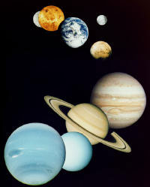
The distance between the Earth and Moon is approximately 245 000 miles. Write this distance in standard form.
2.45 x 10⁵
The distance to the Sun is approximately 93 million miles. Write this distance in standard form.
93 000 000
9.3 x 10⁷

Slide 10
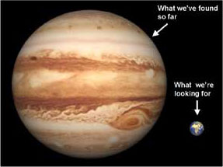
The mass of the Earth is approximately
6 000 000 000 000 000 000 000 000 kg. Write this number in standard form.
6.0 x 10²⁴
The mass of Jupiter is approximately
2 390 000 000 000 000 000 000 000 000 kg. Write this number in standard form.
2.39 x 10²⁷
How many times more massive is Jupiter than Earth?
2.39 x 10²⁷
6.0 x 10²⁴
= 398

Slide 11

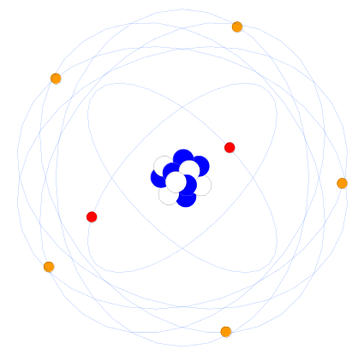
The mass of a uranium atom is approximately
0. 000 000 000 000 000 000 000 395 g.
Write this number in standard form.
3.95 x 10⁻²²
The mass of a hydrogen atom is approximately
0. 000 000 000 000 000 000 000 001 67 g.
Write this number in standard form.
1.67 x 10⁻²⁴
How many times heavier is uranium than hydrogen?
3.95 x 10⁻²²
1.67 x 10⁻²⁴
= 237

Slide 12
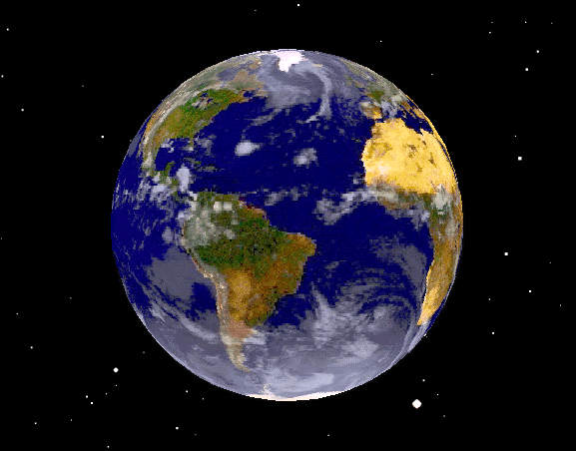
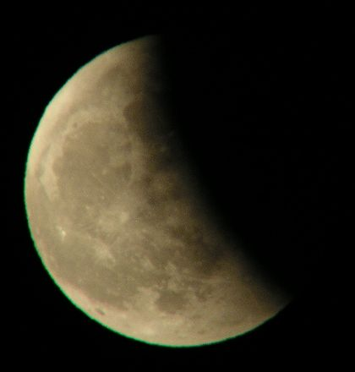

Writing Answers in Decimal Form (Non-calculator)
Taking the distance to the moon is 2.45 x 10⁵ miles and the average speed of a space ship as 5.0 x 10³ mph, find the time taken for it to travel to the moon. Write your answer in decimal form.

Slide 13
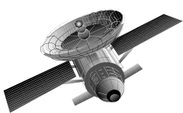
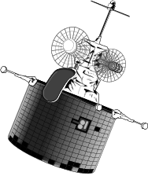
Writing Answers in Decimal Form (Non-calculator)
Two satellites travel distances of 5.8 x 10⁴ and 2.2 x 10⁵ km. Find the combined distance travelled. Write your answer in decimal form.
58 000 + 220 000 = 278 000 km.

